Slide 1

CLASSIFICATION OF SIGNIFICANT WATER RESOURCES AND DETERMINATION OF RESOURCE QUALITY OBJECTIVES FOR WATER RESOURCES IN THE USUTU TO MHLATHUZE CATCHMENTS (WP11387)
8.2 RIVER ECOLOGICAL CONSEQUENCES

Slide 2
RIVER ECOLOGICAL CONSEQUENCES
Delana Louw
Presented by Patsy Scherman

Slide 3
DETERMINING ECOLOGICAL CONSEQUENCES OF SCENARIOS
IUA: Homogenous area that can be managed as an entity.
Need to answer the ‘what if’ questions
Express in terms of change in Ecological Category
Detailed process to predict changes in all the biophysical components per site and per scenario.
Then to integrate and demonstrate in systems context
Include in WRC DSS process

Slide 4




REMINDER: DESCRIPTION OF RIVER STATE
Close to Natural: Good condition
Very different to Natural: Very Poor condition
{
{
Ecological Categories (EC)

Slide 5
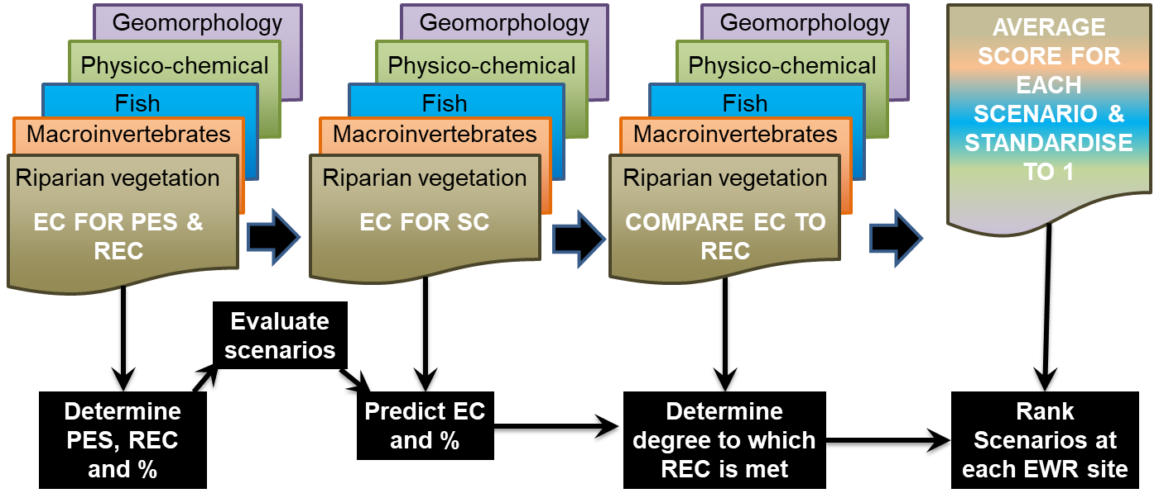
DETERMINING ECOLOGICAL CONSEQUENCES OF SCENARIOS

Slide 6
DETERMINING ECOLOGICAL CONSEQUENCES OF SCENARIOS
RELATIVE ECOLOGICAL IMPORTANCE OF SITES
PES
EIS
Locality in conservation areas
WEIGHT
Ecological ranking of scenarios per EWR site
APPLY WEIGHT
Ecological ranking of scenarios for the system
NB: This process is only relevant if you have more than one EWR site in a system or an EWR site and an estuary

Slide 7
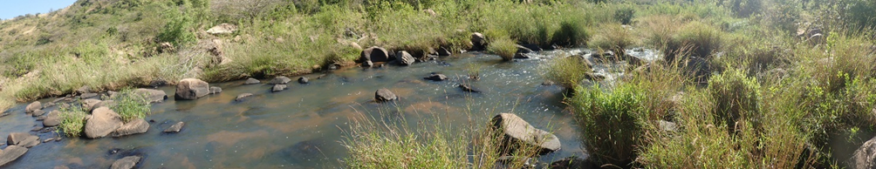
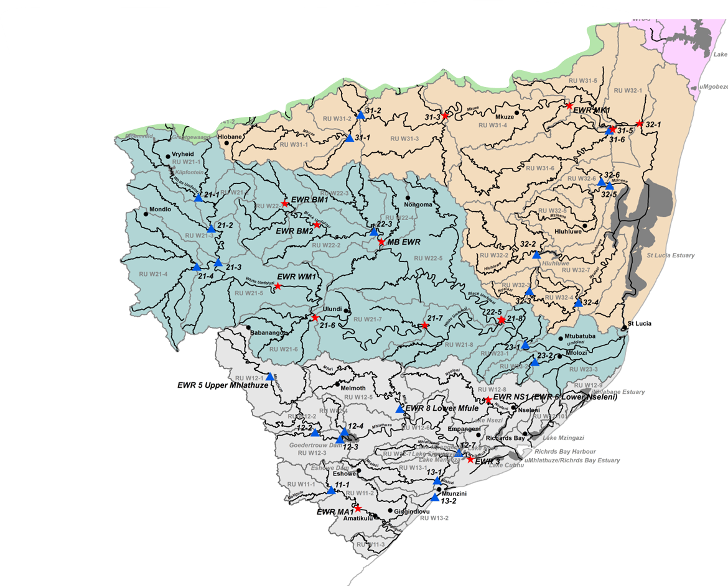
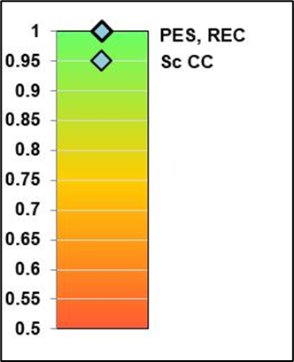
EWR MA1 (MATIGULU RIVER)
RU | RU W11-2
IUA | IUA W11
PES | B/C
EIS | Moderate
REC | B/C
Sc CC | B/C

Slide 8
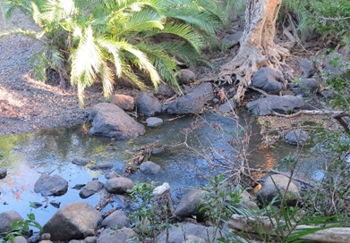
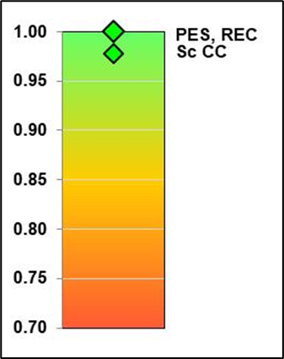
EWR NS1 (NSELENI RIVER)
RU | RU W12-8
IUA | IUA W12-b
PES | C
EIS | Moderate
REC | C
Sc CC | C

Slide 9
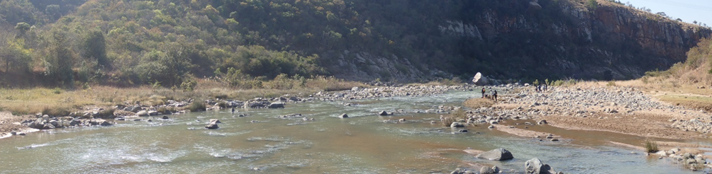
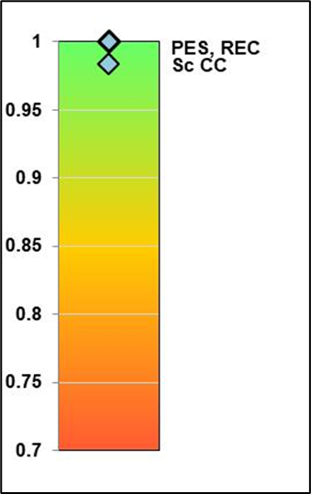
EWR WM1 (WHITE MFOLOZI RIVER)
RU | RU W21-5
IUA | IUA W21
PES | B/C
EIS | Moderate
REC | B/C
Sc CC | B/C

Slide 10
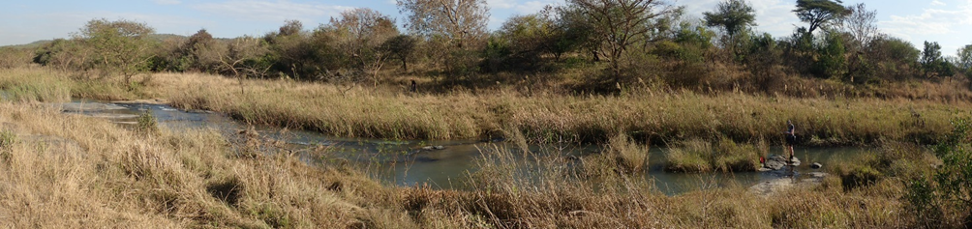
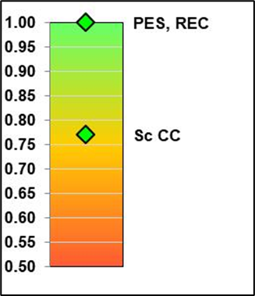
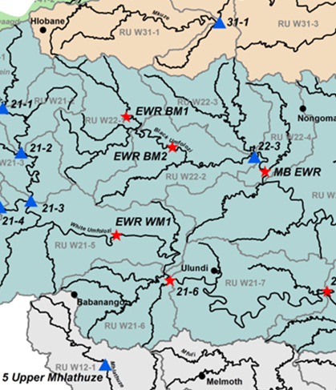
EWR BM1 (BLACK MFOLOZI RIVER)
RU | RU W22-2
IUA | IUA W22
PES | C
EIS | Moderate
REC | C
Sc CC | C

Slide 11
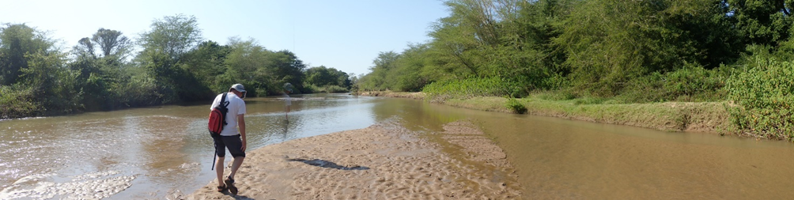
EWR MK1 (MKUZE RIVER)
RU | RU W31-5
IUA | IUA W31-b
PES | C
EIS | High
REC (non flow-related) | B
Scenarios | C
+ non-flow related measures will result in a B

Slide 12
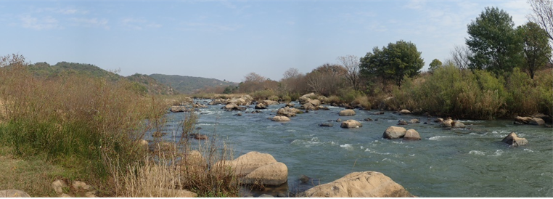
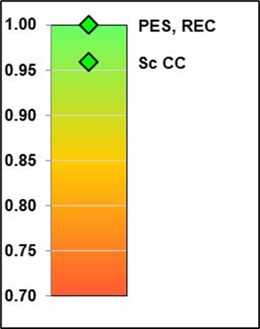
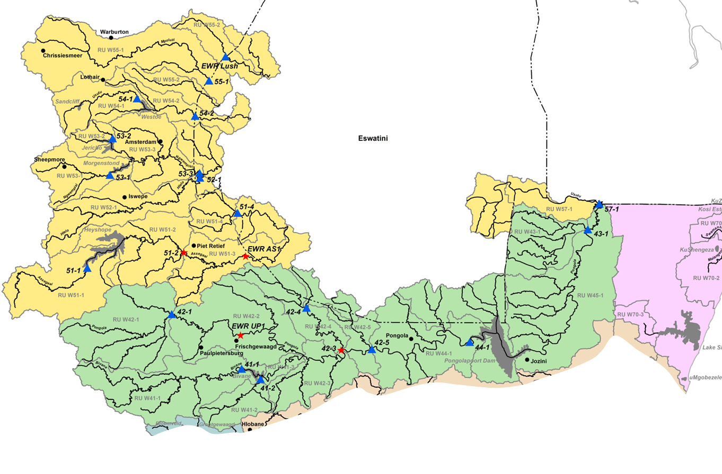
EWR UP1 (upper PONGOLA RIVER)
RU | RU W42-2
IUA | IUA W42-b
PES | C
EIS | Moderate
REC | C
Sc CC | C

Slide 13
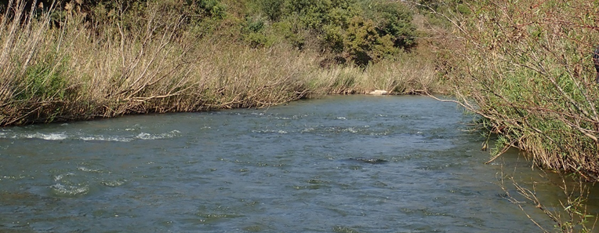
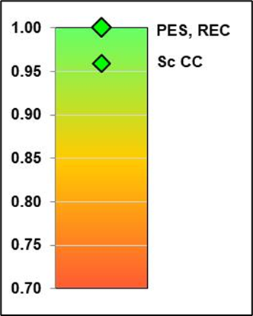
EWR AS1 (ASSEGAAI RIVER)
RU | RU W51-3
IUA | IUA W52
PES | C
EIS | Moderate
REC | C
Sc CC | C

Slide 14
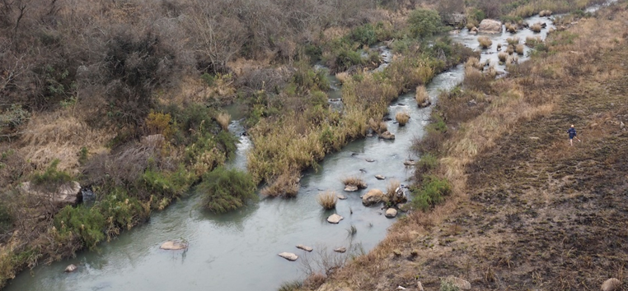
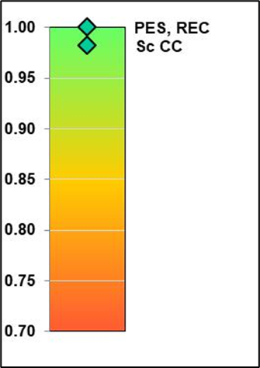
EWR NG1 (NGWEMPISI RIVER)
RU | RU W53-3
IUA | IUA W52
PES | B/C
EIS | Moderate
REC | B/C
Sc CC | B/C

Slide 15
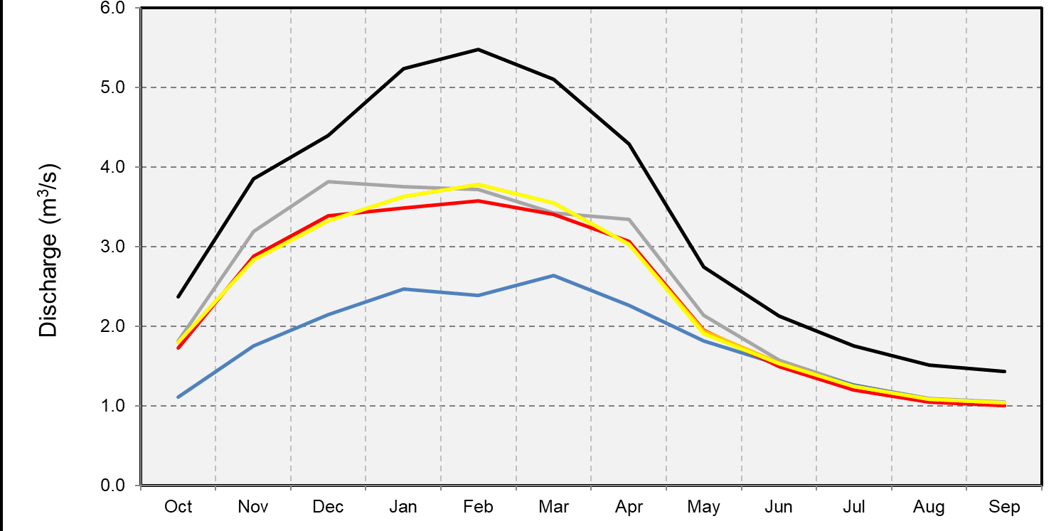
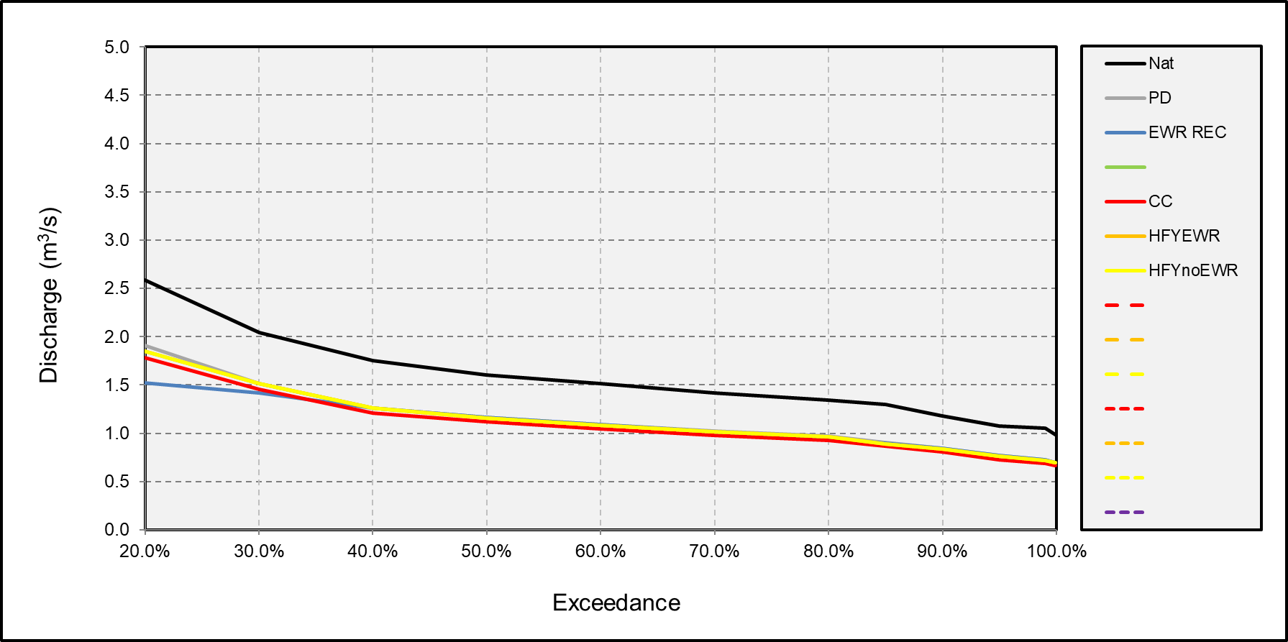
DETERMINING ECOLOGICAL CONSEQUENCES OF SCENARIOS: CONCLUSIONS
All Scenarios very similar
Sc CC marginally worse than other scenarios
Consequences assessment: compared Sc CC to EWR REC
IUA: Homogenous area that can be managed as an entity.
Sc CC
EWR REC
Natural

Slide 16
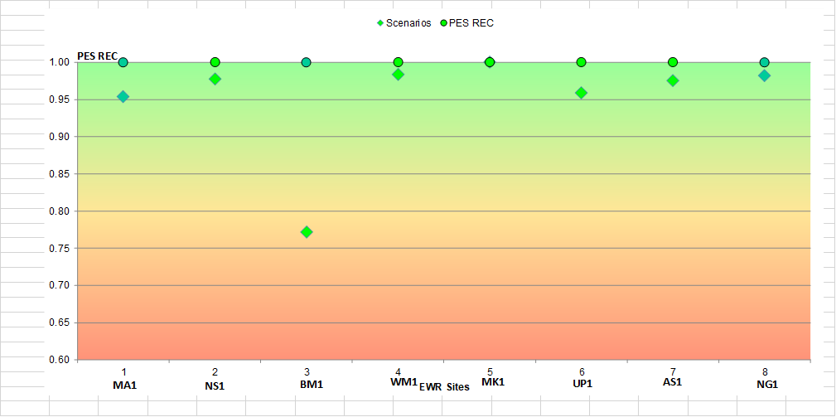
DETERMINING ECOLOGICAL CONSEQUENCES OF SCENARIOS: CONCLUSIONS
All Scenarios meet the REC

